Slide 1
EE2101 – Experiment #1
Introduction to Technical Writing for ECE Labs

Slide 2
Professional Communication in Engineering
    You will always write: Throughout your career, you’ll write everything from emails and cover letters to reports, proposals, and manuals.
    You will be judged based on how you write: Clear, professional writing shapes how others see your ideas—and you. With professional writing, you can get a job, secure funding, publishing research, lead teams, sell your ideas, network with others, and most importantly. earn trust.
    Scope: This class covers the basics of writing two key formats of technical reports: (1) formal reports and (2) informal reports (e.g., lab notebook).

Slide 3
EE2101 Lab Reports
    Two kinds of reports for EE2101 lab:
    Formal report: Follows scientific style—includes abstract, introduction, methodology, results and discussion, conclusion, and references.
    Informal report: Also referred to as the lab notebook, focuses on experiment steps and results—less emphasis on structure or citations.
    In the following, we investigate structure and sections of both formal and informal reports.

Slide 4
Report Preliminaries
    For both formal and informal reports, start by filling (i) your experiment title, (ii) your name, (iii) your affiliation, and (iv) email address.
    For affiliation, include your program year, program, department, and university name; example:
    “Freshman, Electrical Engineering, ECE department, Missouri S&T”
    For your email address, please use your official Missouri S&T email address.
    Wrong email address: joe.miner@gmail.com.
    Correct email address: joe.miner@umsystem.edu or joe.miner@mst.edu.

Slide 5
Abstract
    The abstract is usually “unnumbered section” of the formal report and placed before Section 1 (Introduction) without a section number.
    The abstract is just a short summary about the whole document usually in one paragraph.
    To write abstract, (i) start by stating the goal (what you intend to do in this experiment, what question(s) you intend to answer), (ii) then include an upper-level description about the method you used to achieve your goal, and finally (iii) provide a short comment about the main results.
    The abstract should be short and summarize the entire document.
    As mentioned, the abstract should provide a brief upper-level comment on your results/conclusion. For this purpose, it is recommended to write the abstract at the end, after completing the entire report.

Slide 6
Abstract
The Goal
The Method
    Example of professional abstract:
    “In this experiment, we aim to investigate the characteristics and applications of analog multimeters. To do so, we constructed various circuits to measure the internal resistance, we designed shunt resistors to extend ammeter range, and we evaluated the sensitivity of the device via ohm/volt analysis. The results match the expected theory, while the results show that the methods that rely on decade resistor box for internal resistor have resulted errors compared to the decade box free methods.”
The Main Result/Conclusion

Slide 7
Exercise-1
    Using the attached report-1 and the exercise sheet; write a professional abstract for the given report-1.

Slide 8
Section-1: Introduction
    The first section of your formal report is the introduction. The introduction should provide a clear explanation of the fundamental concepts and theory relevant to the experiment. You need to explain all background theory related to the topic.
    To do so, consider your audience before writing—how familiar is the reader with the experiment's background theory? Please consider that you don’t necessary write for your instructor but rather a more generic audience.
    For EE2101 assume that your audience has basic scientific knowledge such as physics, mathematics, and basic circuits theory (e.g., your friend from mechanical engineering department).
    For writing your formal report your explanation should be well-supported with (1) mathematical expressions, (2) figures and (3) references to enhance clarity and comprehension.

Slide 9
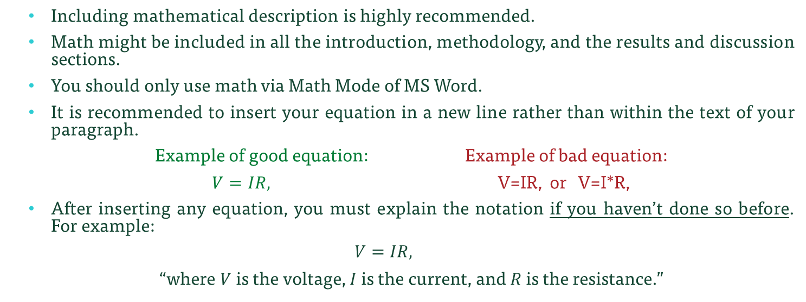
Section-1: Introduction – Math
    Including mathematical description is highly recommended.
    Math might be included in all the introduction, methodology, and the results and discussion sections.
    You should only use math via Math Mode of MS Word.
    It is recommended to insert your equation in a new line rather than within the text of your paragraph.
    Example of good equation: Example of bad equation:
    $V=IR,$ V=IR, or V=I*R,
    After inserting any equation, you must explain the notation if you haven’t done so before. For example:
    $$V=IR,$$
    “where $V$ is the voltage, $I$ is the current, and $R$ is the resistance.”

Slide 10
Section-1: Introduction – References
    For a formal report, you need to cite at least one reference.
    You may cite books, research papers, or web-articles.
    In professional settings, people will judge you based on the quality of your references!
    To cite a reference, you must include both: (i) in text citation and (ii) the reference at the references section. Example:
    “Analog multimeters work by using a moving-coil galvanometer to measure current, voltage or resistances [1]”
    References:
    [1] A. S. Morris, Measurement & Instrumentation Principles. Elsevier, 2001.
In-text citation
The reference at the references section

Slide 11
Section-1: Introduction – References
    Expressing your reference is not random. There are many referencing styles (e.g., MLA, APA, Chicago-style, IEEE-style, …etc) and you must follow one of these.
    For EE2101, we recommend following IEEE-style.
    Examples of how to express your reference using IEEE-style can be found in this link: ieee-dataport.org/sites/default/files/analysis/27/IEEE Citation Guidelines.pdf
    In the previous example [1] is a “Single Author Book” which should be cited according to IEEE style as:
    “[1] A. S. Morris, Measurement & Instrumentation Principles. Elsevier, 2001.”

Slide 12
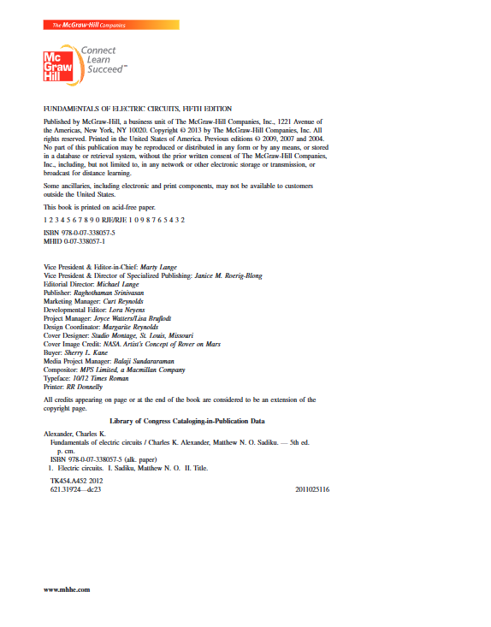
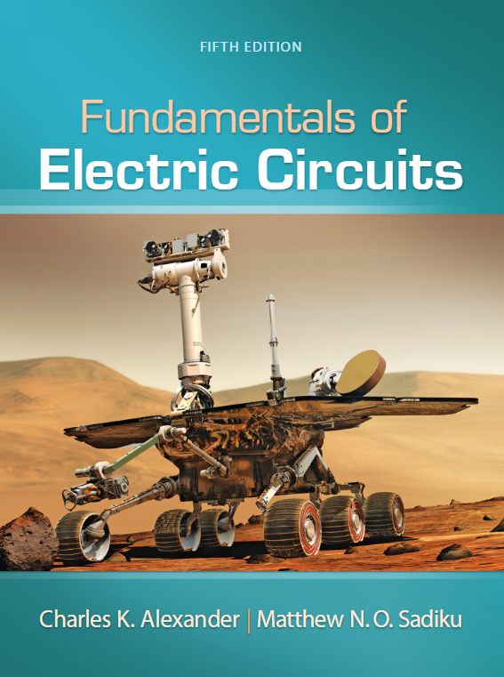
Exercise-2
    Using the information provided on the cover page and the first page, write a citation for the book in IEEE style
    (Hint: you might refer to ieee-dataport.org/sites/default/files/analysis/27/IEEE Citation Guidelines.pdf)

Slide 13
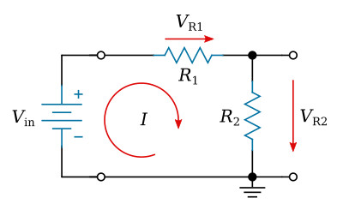
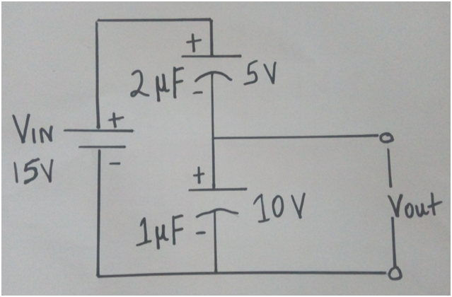
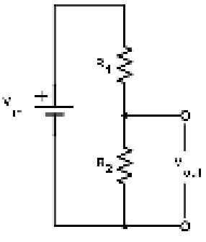
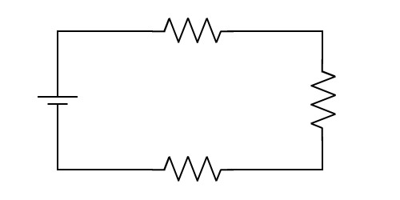
Section-1: Introduction – Figures / Tables
    You might need to use figures/tables to support your explanation in the introduction section. You will surly need figures in the methodology and results section.
    When inserting a figure, you need to choose a figure with high-quality if possible. A high-quality figure has the following aspects: (i) it should not be pixelated or blurry figure, (ii) the information displayed in the figure (e.g., text, numbers, notations, … etc) should be easily readable, (iii) the background of the figure should match the background of the page (e.g., white page in this case), and (iv) the figure format should be consistent.
Bad: photos are not allowed
Bad: pixelated
Good
Bad: no labels

Slide 14
Section-1: Introduction – Figures / Tables
    It is very common that you might need to draw your custom circuit diagram. For this purpose, we recommend using the open-source and online circuit drawer tool “Circuit Diagram” that can be accessed via this link:
    https://www.circuit-diagram.org/editor/

Slide 15

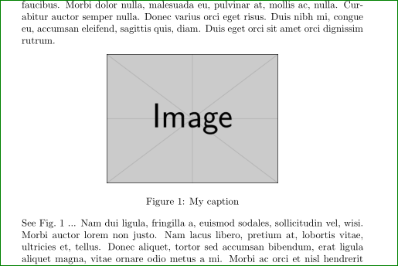

Section-1: Introduction – Figures / Tables
    The figure should be placed (positioned in the page) appropriately, it is recommended to place your figures on the top of your page. The top space of your page has the space to hold two to three small square figures or one wide rectangular figure.
Bad
Good
Better

Slide 16
Section-1: Introduction – Figures / Tables
    When placing a figure you must do the following: (i) the figure must always have an identifier and caption. (ii) you must cite your figure in-text.
    For figures, identifier and caption should be under the figure. For tables, identifier and caption should be above the table.
    Example of a figure with appropriate figure, identifier, and captions:
Figure-1 below illustrate the voltage divider circuit we intend to build in this experiment
In-text citation
Identifier
Caption
Figure-1: voltage divider circuit.

Slide 17
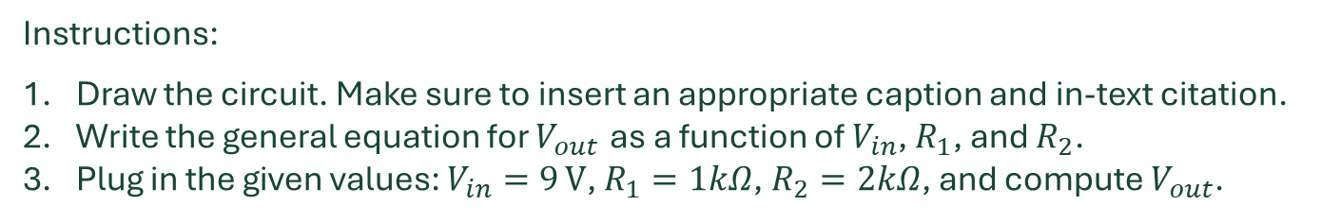
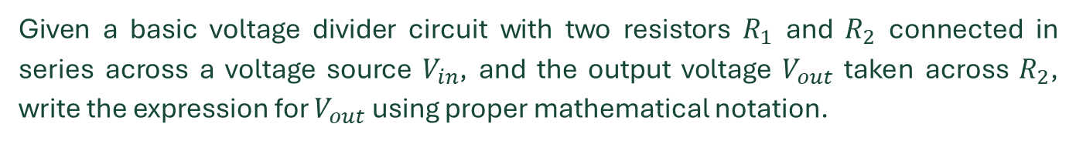

Exercise-3
Given a basic voltage divider circuit with two resistors $R_{1}$​ and $R_{2}$​ connected in series across a voltage source $V_{in}$​, and the output voltage $V_{out}$ ​taken across $R_{2}$​, write the expression for $V_{out}$ using proper mathematical notation.
Instructions:
Draw the circuit. Make sure to insert an appropriate caption and in-text citation.
Write the general equation for $V_{out}$ as a function of $V_{in}$​, $R_{1}$​, and $R_{2}$​.
Plug in the given values: $V_{in}=9 V$, $R_{1}=1kΩ$, $R_{2}=2kΩ$, and compute $V_{out}$​.
Expected output format (example):
$$V_{out}=\frac{R_{2}}{R_{1}+R_{2}}×V_{in}=\frac{2000}{1000+2000}×9=6V$$
Hint: you can use https://www.circuit-diagram.org/editor/ to draw your circuit)

Slide 18
Section-1: Introduction – Figures / Tables
    When inserting tables, please use formal black and white design/format.
    You might edit tables borders width if needed.
Bad table style
Good table style
Voltage | Current
Voltage | Current

Slide 19
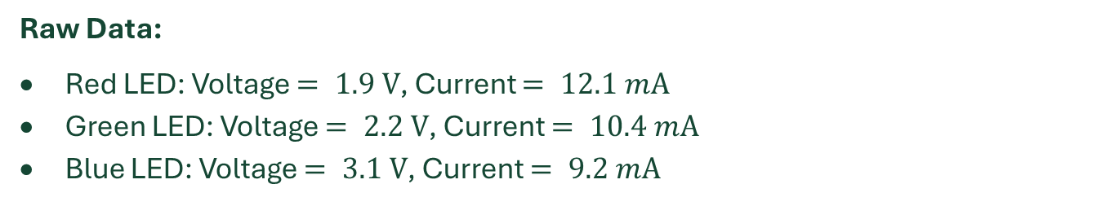
Exercise-4
The following data shows the forward voltage and current of different LED colors measured in a lab. Your task is to organize the data into a professionally formatted table with:
(A) Proper column headers and units (B), a descriptive caption, and (C) in-text citation referencing the table
Raw Data:
Red LED: Voltage $= 1.9 V$, Current $= 12.1 mA$
Green LED: Voltage $= 2.2 V$, Current $= 10.4 mA$
Blue LED: Voltage $= 3.1 V$, Current $= 9.2 mA$

Slide 20
Section-1: Introduction – Others
    The final paragraph of your report should include a summary of what you intend to make in this report. (1) Start with a generic upper-level objective of your report, (2) after that, break down your generic upper-level objective into smaller goals, the smaller goals should balance all the aspects of your experiment.
    The usage of bullets here is really preferable.
    Example:
    In this experiment, we aim to investigate the characteristics and applications of analog multimeters. Specifically:
    • We examine different methods and techniques for measuring the internal resistance of an analog multimeter.
    • To extend its measurement range, we design and implement a shunt resistor circuit.
    • We perform an ohm/volt analysis by evaluating the analog multimeter across various load resistances.

Slide 21
Section-1: Introduction – Others
    The formatting and presentation are significantly important and can express your professionalism. Your report should be typo-free, no grammar errors, have an appropriate use of the language, have consistent high-quality figures and tables, have appropriate use of punctuation marks, and have a consistent use of appropriate mathematical notations.
    When writing any report, use the “justify” format on all your paragraphs, don’t use “align left”, “center”, or “align right”. The following two paragraphs are examples of appropriate and non-appropriate text alignment:

Slide 22
Section-1: Introduction – Others
Exemplary appropriate alignment:
An analog multimeter is a versatile electrical measuring instrument used to measure voltage, current, and resistance. It features a needle that moves across a scale to display readings, offering real-time fluctuations that digital multimeters may not capture. Though less precise than digital models, analog multimeters are valued for their responsiveness and ability to detect transient changes in electrical signals, making them useful in certain applications like tuning circuits and troubleshooting dynamic electrical systems.
Exemplary non-appropriate alignment
An analog multimeter is a versatile electrical measuring instrument used to measure voltage, current, and resistance. It features a needle that moves across a scale to display readings, offering real-time fluctuations that digital multimeters may not capture. Though less precise than digital models, analog multimeters are valued for their responsiveness and ability to detect transient changes in electrical signals, making them useful in certain applications like tuning circuits and troubleshooting dynamic electrical systems.

Slide 23
Section-1: Introduction – Others
    You should follow the requested template specifically. This means that you shouldn’t change font size, font color, paragraph spacing, page margin, or any other formatting.
    You should make the appropriate usage of tense and voice.
    The general rule of thump is that we use the “present tense” in the introduction and conclusion sections, the “past tense” for methodology and results sections, and “future tense” if you have a future work section.
    Moreover, you should be consistent in the usage of either the “third-person (passive voice)” (e.g., the circuit has been constructed according to Figure 1) and the “first-person (active voice)” (e.g., we constructed the circuit according to Figure 1). The “third-person” is usually more formal and preferable although that the “first-person” is highly popular and acceptable.
    When using the “first-person”, use the pronoun “we” and never use “I”.

Slide 24
Section-1: Introduction – Others
    When writing your report stick to the “formal professional” language and avoid using “casual language”.
    Format your report to cover white spaces if possible.
    Your report should be good-looking, symmetrical, consistent, and with minimum white spaces; writing a report is an art! Don’t forget that you must read your report before submission.
    For EE2101 The whole introduction section should be at least ¾ of page in length.

Slide 25
Exercise-5
You are given a sample paragraph below. Your task is to edit it to meet the formatting and style requirements typically expected in EE2101 lab reports.
Sample Text
“the circuit is Built accOrding to fig. 1 and tested using a voltmeter. we did the measurments at three points .the data is shown in table 1. it show that the blue led lights up only at 5v.the red one work at 2V.this tells us which one to choose”

Slide 26
Section-2: Methodology
    The methodology is the second section of your formal report, it is also an important section of your informal report. In the methodology you need to write and explain the experimental steps that you have conducted to perform your experiment and collect your results.
    The key concept here is that your description should make the experiment to be “reproducible”. This means that anyone who read your report should be able to conduct the same exact experiment under the same exact settings and use the same exact devices/tools to collect the same exact numerical results.

Slide 27
Section-2: Methodology
    To write the methodology section, (i) start by explaining your experimental procedure in upper-level description, (ii) after that, break down your methodology into subsections and report the experimental steps in the appropriate subsections. Example:
    II. Methodology
    We aim to investigate the characteristics and applications of analog multimeters. To do so, construct various circuits to measure the internal resistance; after that, we designed shunt resistors to extend ammeter range; and finally, we evaluated the sensitivity of the device via ohm/volt analysis. In the following we describe each of the experimental steps.
    A. Measuring the internal resistance of an analog multimeter.
    Your experimental steps for subsection II.A here.
    B. Extending the analog multimeter range using shunt resistor.
    Your experimental steps for subsection II.B here.
    C. Evaluating the sensitivity of the analog multimeter.
    Your experimental steps for subsection II.C here.
Section II, the methodology.
Subsection II.A
Upper-level description of the methodology
Subsection II.B
Subsection II.C

Slide 28
Section-2: Methodology
    In any of these subsections, you need to “generalize” in your description. In another words, don’t design your methodology on how to conduct the experiment on the very specific circuit you constructed in the lab, but rather how to conduct the experiment on any generic circuit.
    You will probably need to insert figures that show circuit diagrams that you have built; don’t refer to the diagram from the notebook, but rather insert.
    Bad practice: “we constructed the circuit in Figure-1 in the lab manual”.
    Good practice: “we constructed the circuit in Figure-1 above” (with actual circuit inserted).
    For the methodology section, don’t insert the values of elements/tools that you have actually used (i.e., resistances values, utilized voltage values … etc). Report these values in the results section and not in the methodology.

Slide 29
Exercise-6
You’re reviewing a peer’s methodology paragraph below. Your task is to assess its reproducibility and improve it.
Peer’s Methodology Paragraph:
“We did the experiment using some resistors and LEDs. The circuit was built just like we saw in the lab. Then we turned on the power and looked at what happened. We wrote down what we saw. A multimeter was used sometimes.”
List 3–5 specific reasons why the paragraph is not reproducible.

Slide 30
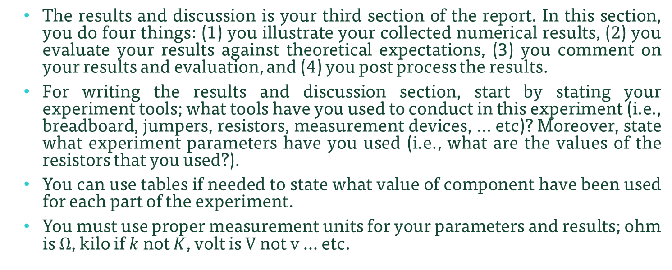
Section-3: Results and Discussion
    The results and discussion is your third section of the report. In this section, you do four things: (1) you illustrate your collected numerical results, (2) you evaluate your results against theoretical expectations, (3) you comment on your results and evaluation, and (4) you post process the results.
    For writing the results and discussion section, start by stating your experiment tools; what tools have you used to conduct in this experiment (i.e., breadboard, jumpers, resistors, measurement devices, … etc)? Moreover, state what experiment parameters have you used (i.e., what are the values of the resistors that you used?).
    You can use tables if needed to state what value of component have been used for each part of the experiment.
    You must use proper measurement units for your parameters and results; ohm is $Ω$, kilo if $k$ not $K$, volt is $V$ not $v$ … etc.

Slide 31
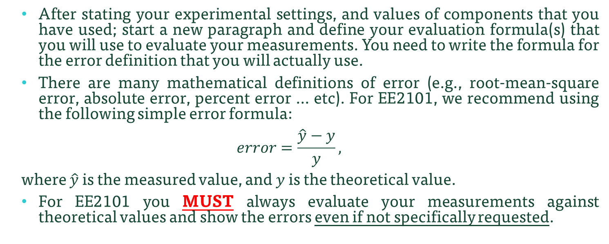
Section-3: Results and Discussion
    After stating your experimental settings, and values of components that you have used; start a new paragraph and define your evaluation formula(s) that you will use to evaluate your measurements. You need to write the formula for the error definition that you will actually use.
    There are many mathematical definitions of error (e.g., root-mean-square error, absolute error, percent error … etc). For EE2101, we recommend using the following simple error formula:
    $$error=\frac{\hat{y}−y}{y},$$
    where $\hat{y}$ is the measured value, and $y$ is the theoretical value.
    For EE2101 you MUST always evaluate your measurements against theoretical values and show the errors even if not specifically requested.

Slide 32
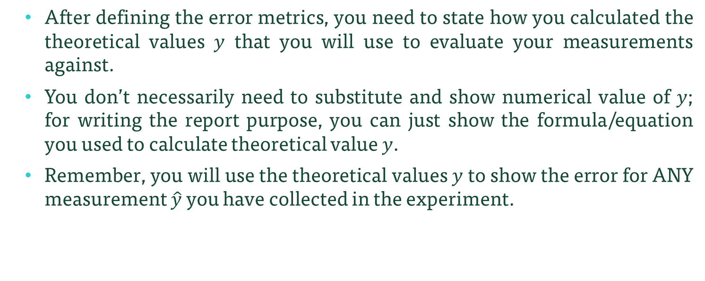
Section-3: Results and Discussion
    After defining the error metrics, you need to state how you calculated the theoretical values $y$ that you will use to evaluate your measurements against.
    You don’t necessarily need to substitute and show numerical value of $y$; for writing the report purpose, you can just show the formula/equation you used to calculate theoretical value $y$.
    Remember, you will use the theoretical values $y$ to show the error for ANY measurement $\hat{y}$ you have collected in the experiment.

Slide 33
Section-3: Results and Discussion
    So far, you have stated experiment settings and components values, you have defined the error formula(s) and stated how you have calculated theoretical values. The next step is to break down the results section into subsection in a very similar manner to what you have done in the methodology section. In each subsection, you need (1) to state the collected results, (2) to show the error, (3) to comment on the error, and (4) to post process collect data if needed.

Slide 34
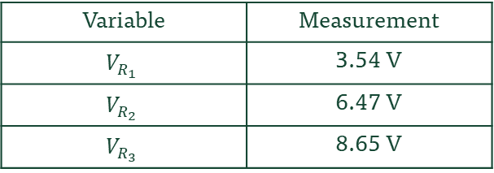
Section-3: Results and Discussion
    For stating the collected results, you are highly recommended to use tables to illustrate measurements. An alternative approach is to state results in paragraph, use bold letters in this case
    Example-1
Table-1: results for part-A of the experiment.
Variable | Measurement
$$V_{R_{1}}$$ | 3.54 V
$$V_{R_{2}}$$ | 6.47 V
$$V_{R_{3}}$$ | 8.65 V
    Example-2
    The collected results indicate 3.54 V across $R_{1}$, 6.47 V across $R_{2}$, and 8.65 V across $R_{3}$

Slide 35
Section-3: Results and Discussion
    In lab environment, it is common that the theoretical values do not match the experimental measurements. This can happen due to many reasons, for instance (i) the theory might not work practically, (ii) you have conducted mistakes in your experimental steps, or during collection of results, (iii) the equipment in the lab might be malfunctioning … etc. For high errors, you must always comment on the potential reasons of the errors.
    You should also comment on other small errors, why didn’t you get 0% error?

Slide 36
Section-3: Results and Discussion
    In many cases it would be recommended to utilize figures to illustrate results or express errors.
    A professional figure should be (1) high quality, (2) numbers on both x-axis and y-axis are large enough for readability, (3) should include x-label and y-label with units of measurements and (4) should not have figure title on top of the figure.
    Moreover, 10% of men are color blind, for this purpose, if multiple figures are to be plotted on the same axis you need to follow the following recommendations to enhance accessibility of your figure: (1) the line style of the different figures should be different and (2) a legend for the figure should be included.

Slide 37
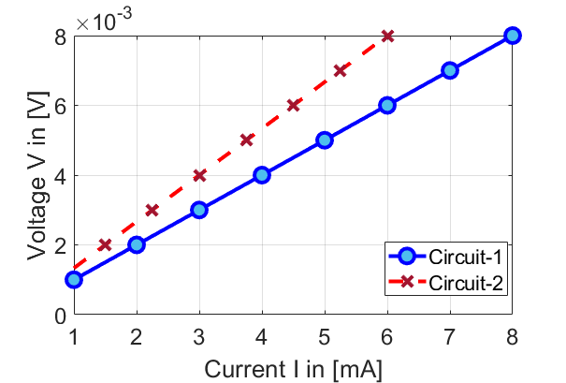
Section-3: Results and Discussion
Curve styles are different, this will enhance readability for users with disabilities
    Example of professional high quality figure
Legend is used for multiple curves identification
Axis numbers are readable
Labels with units

Slide 38
Section-3: Results and Discussion
    In some cases, you might need to post-process the results to estimate new parameters, or to conduct farther investigation.
    For example, can you estimate the resistance for both circuits?
Hint: use ohm’s law

Slide 39
Section-3: Results and Discussion
    Results and discussion section might look as the following:
    III. Results and Discussion
    First paragraph: state tool/equipment that you have utilized and state the values of components that have been used (either in paragraph or in table(s)).
    Second paragraph: define the evaluation criteria and error formulas.
    Third paragraph: state how you have computed theoretical values that will be used in evaluation.
    III.A results of part-A
    State your results, state your errors, comment on the errors, post process results if needed.
    III.B results of part-B
    State your results, state your errors, comment on the errors , post process results if needed.
    III.C results of part-C
    State your results, state your errors, comment on the errors , post process results if needed.

Slide 40
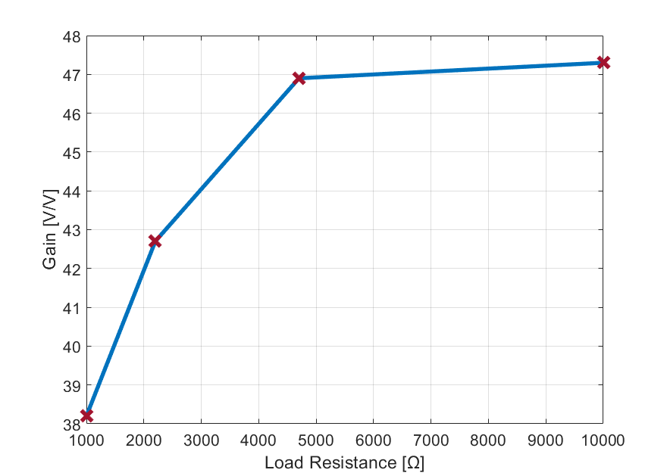
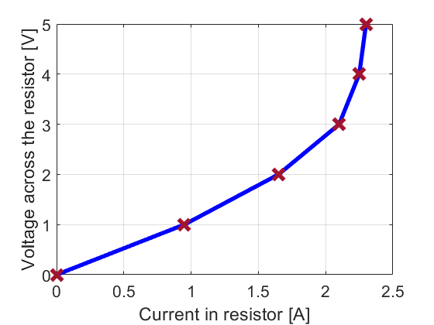
Exercise-7
Discuss and comment on the following results
Table 1: Sensor Output Voltage vs. Light Intensity.
Light Intensity (lux) | Output Voltage (V)
0 | 0.02
100 | 0.52
200 | 0.98
300 | 0.73
400 | 1.89
Figure 1: Amplifier Gain with Different Loads.
Figure 2: Measured voltage vs current across a resistor.

Slide 41
Section-4: Conclusion
    The conclusion section is your final section in the report.
    This section should include one paragraph that include the following: (i) Summary of Key Findings – briefly restate the main results of this experiment. (ii) Limitations – mention any constraints or factors that may have affected the results. (iii) Future Work – suggest possible improvements.

Slide 42
Optional Section: Acknowledgment
    Optionally, you might include acknowledgment section.
    This section is optional, you might use it if you want to acknowledge any support or help you received to make this experiment, process the data, or gain the necessary theory.
    You don’t need to acknowledge your class instructor, recall that they are paid to do this service.
    Ignoring to acknowledge who really voluntarily assisted/helped you in conducting your report is rude!
    The preferred spelling of the word “acknowledgment” in America is without an “e” after the “g”.

Slide 43
Formal References
    Finally, state your references.
    It is preferable to follow IEEE style. One reference is enough for EE2101 formal report, but you can place more if needed.

Slide 44
Formal report
    Formal report structure
    Title – Name – Affiliation – Email address.
    Abstract
    Summarize the documents, comment on goal, method, and main results in one paragraph.
    I. Introduction
    Has theory and background support with math, figures and references.
    II. Methodology
    Should be structured and should include all steps that ensure your experimental steps are reproducible.
    III. Results and Discussion
    State the collected results, show the errors, comment on the error, and post process collect data if needed. Include experimental settings, evaluations metrics, and theoretical derivations.
    IV. Conclusion
    Summarize key findings, comment of limitations, state future work if needed.
    [Optional] Acknowledgment
    Acknowledge any support or help you received to make this experiment
    References
    Include at least one reference, follow IEEE referencing style.

Slide 45
Informal Report (Lab Notebook)
    Informal report is another format of technical reports that you be using in EE2101. Informal reports is a structured but less formal document used to record experimental work, including objectives, procedures, Results, Discussion and Conclusions, mainly for internal use and learning.
    In the following, we go through the structure of the informal report section by section.

Slide 46
Informal Report – Title/Name/Affiliation/Email
    Similar to formal reports, start by filling (i) your experiment title, (ii) your name, (iii) your affiliation, and (iv) email address.
    For affiliation, include your program year, program, department, and university name; example:
    “Freshman, Electrical Engineering, ECE department, Missouri S&T”
    For your email address, please use your official Missouri S&T email address.
    Wrong email address: joe.miner@gmail.com.
    Correct email address: joe.miner@umsystem.edu or joe.miner@mst.edu.

Slide 47
Informal Report – Objectives
    The first section of the informal report is stating experiment objectives.
    Start by stating the experiment topic in a very upper-level statement.
    Then state the specific goal(s) questions that you intend to answer in bullet points.
    Reader should be able to understand experiment scope and questions to be answered by reading the objectives section.
    Example
    Objectives
    In this experiment, we intend to investigate analog multimeters, more specifically:
    We test various methods to measure the internal resistance of an analog multimeter.
    We design shunt resistors and use it to extend the range of analog multimeter.
    We test the sensitivity of the analog multimeter using ohm/voltage analysis.

Slide 48
Informal Report – Procedure
    The second section - the procedure – is very similar to the methodology section in the formal report. It is intended to state the experimental steps such that the experiment is reproducible.
    Similar to the methodology section in the formal report, you need to keep the subsections that indicate each part of the experiment; however, write the experimental steps of each subsection in bullet points.
    Similar to the methodology section, you might need to insert figures (e.g., circuit diagrams).
    One difference between methodology section in the formal report and procedure section in the informal report, is that you need to state equipment, and values of components you have used in the experiment.

Slide 49
Informal Report – Procedure
    Example
    Procedure
    Part-A
    1- step-1
    2- step-2
    … etc
    Part-B
    1- step-1
    2- step-2
    … etc

Slide 50
Informal Report – Results
    This section is very similar to the results and discussion section of the formal report; with the following key-differences.
    No need to define experiment settings or parameters values; in the informal report, you need to report these details in the procedure section.
    No need to define evaluation metrics. For EE2101 informal reports, it is assumed that students will use the simple error formula provided in the previous slide. If you choose to use a different formula, you must clearly state it.
    No need to state theoretical derivation of the theoretical values.

Slide 51
Informal Report – Results
    For the results section in the informal report, you need to directly (i) state your results, (ii) state errors in measurements, and (iii) comment on the error.
    Similar to formal reports, you still need to use professional figures/tables to express your results.

Slide 52
Informal Report – Discussion
    Unlike the formal report, we split the discussion section from the result section. The discussion section is a separate section that follow the results section in the informal report.
    The lab manual will include questions related to the experiment measurements/concepts, these questions should be answered in this section.
    Moreover, your instructor might assign other question that are not listed in the lab manual. These questions should also be answered in this section.
    Follow a question and answer structure for this section, directly write the questions and then answer the questions.
    Example
    Discussion
    Q1. Question-1
    A1. Answer to question-1.
    Q2. Question-2
    A2. Answer to question-2.
    … etc

Slide 53
Informal Report – Conclusion
    The conclusion section is your final section in the report.
    This section should include one paragraph that include the following: (i) Summary of Key Findings – briefly restate the main results of this experiment. (ii) Limitations – mention any constraints or factors that may have affected the results.

Slide 54
Informal Report – [Optional] Acknowledgment
    Optionally, you might include acknowledgment section.
    This section is optional, you might use it if you want to acknowledge any support or help you received to make this experiment, process the data, or gain the necessary theory.
    You don’t need to acknowledge your class instructor, recall that they are paid to do this service.
    Ignoring to acknowledge who really voluntarily assisted/helped you in conducting your report is rude!
    The preferred spelling of the word “acknowledgment” in America is without an “e” after the “g”.

Slide 55
Informal Report – Others
    While informal report is meant to be rapid and brief, you still need to follow professional writing tips mentioned in the formal report part. This include handling figures and tables, handling math, quality of writing … etc.

Slide 56
Informal report
    Informal report structure
    Title – Name – Affiliation – Email address.
    Objectives
    Directly state the objectives of the experiment in bullet points.
    Procedure
    Divide the experiment into parts (subsections), write the experimental steps of each part in bullet points. Include circuit diagrams, values of components, and utilized equipment. Experiment should be reproducible.
    Results
    Directly show your results, show the errors, and comment on the errors.
    Discussion
    Answer question assigned to you by lab manual or by the instructor.
    Conclusion
    Summarize key findings, comment on limitations.
    [Optional] Acknowledgment
    Acknowledge any support or help you received to make this experiment.

